Slide 1
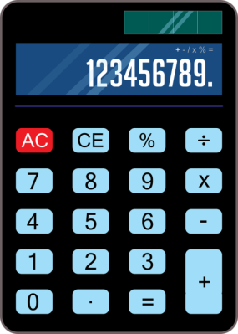

Python based calculator using tkinter
Sanskriti sharma

Slide 2

Operations
Added
ADDITION
+
SUBSTRACTION
-
DIVISION
/
MULTIPLICATION
X

Slide 3
Challenges Faced
Layout challenges
Placement of buttons according to grid.
Deciding the dimension so that buttons can fit in and look aesthetic.
Defining function
With beginner knowledge faced many errors while working on functions.
Including indention errors ,defining a variable

Slide 4
Overcoming Challenges
Following things helped in overcoming the challenges
Watching video tutorials.
Researching online material.
Nexthikes weekly meetings helped in understanding the project.
Trying with different codes and accepting the best outcome.

Slide 5



Refrences
used
Geeksforgeeks
W3School
Additional
Functions used
Creating function using def
Best part of the project
Pooping of the calculator.
Whole learning process.
WsCube Tech (youtube channel)
Aligning centre using sys_width,sys_height

Slide 6

THANK
YOU

